Slide 1


UNDER SUPERVISION
Dr. Safi Ibrahim
Lecturer, Department of Information Technology at Egyptian E-Learning University (EELU)
Eng. Rofida Abd El-Hafez Mohamed
Teacher Assistant, Department of Information Technology at Egyptian E-Learning University (EELU)

Slide 2
Prepared By :
Web
ML
Flutter
Mohamed Khaled Mohamed
Omar Ali Amer
Mohamed Mostafa Mohamed
Shaza Ayman Amin Ahmed
Nermeen Khaled Mohamed
Mohamed Osman Ebn Affan Mohamed
Mostafa Gaber Ahmed Hussein

Slide 3
TABLE OF CONTENTS
01.
02.
03.
04.
05.
Introduction
Related works
Problem statement
Problem solutions
Requirements

Slide 4
TABLE OF CONTENTS
06.
07.
08.
09.
10.
Tools
System methodology
Prototype
11.
Time plans
Videos
References

Slide 5
01.
Introduction

Slide 6
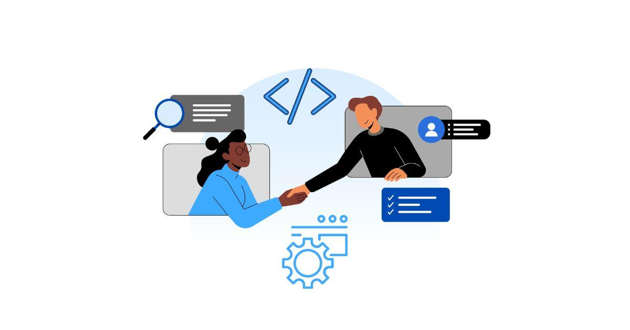
Introduction
A roadmap is a strategic planning tool that provides a visual representation of the goals and to achieve a desired outcome.
It defines the path forward and guides the decision-making process.
Roadmap is not static documents and are subject to change as circumstances evolve.
Regular reviews and updates are necessary to reflect new information, changing priorities, and emerging opportunities or challenges.

Slide 7
7.1 billion smartphones user
Number of smartphone users in millions

Slide 8
5.1 billion Desktop user
Number of Desktop users in millions

Slide 9
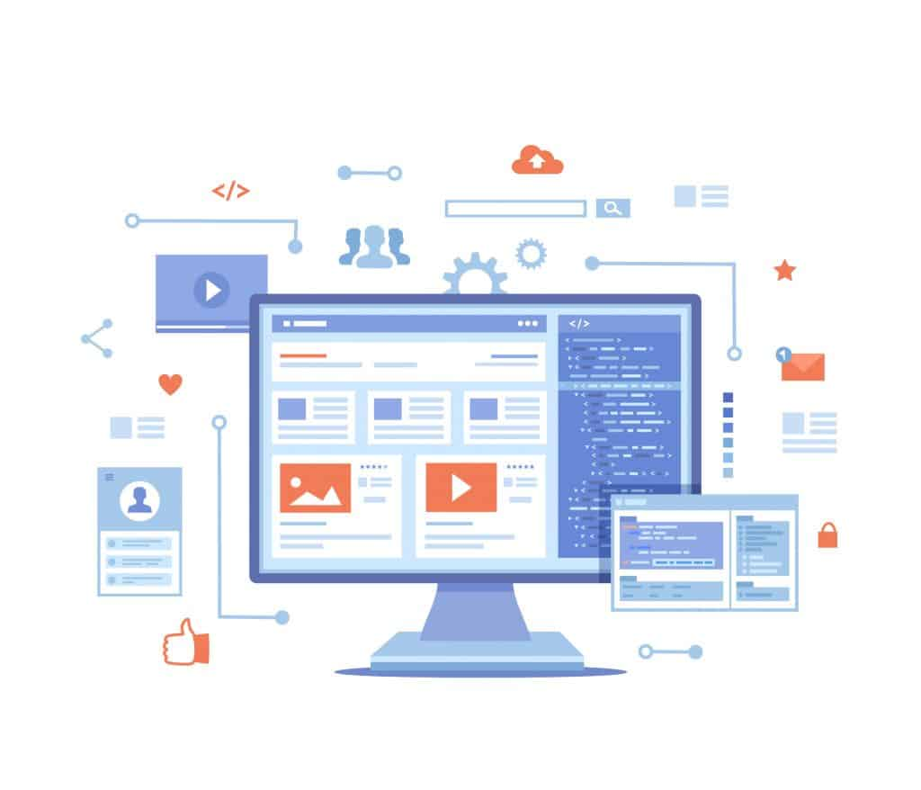
Importance of Roadmap
A roadmap is a tool that helps you plan your journey to success. It's a visual representation of your goals, strategies, and obstacles. A roadmap can make all the difference in achieving your desired outcome. Without a roadmap, you may find yourself lost, unsure of which direction to take.
Roadmaps are crucial tools in various fields like technology , technical and even personal development.
We will provide various educational resources and introduction to each field of information technology. Whether you want to advance your development skills, learn mobile applications, explore reference information, or see basic information, security, information.

Slide 10
02.
Related works

Slide 11
MaharaTech :
Itrax Academy :
ITI online learning platform, serves
as a vital training arm of the
Ministry of Communication and
Information Technology, providing
scholarships and free access to IT
online learning.
Its programming academy to study any topic, anytime and explore thousands of courses.

Slide 12


Related works

Slide 13
03.
Problem statement

Slide 14
Problem statement
Lack of experience
Resource Barriers in education
Newcomers cannot choose the appropriate field for them, and some others could not complete the path they choose.
Some students may face difficulty in accessing the resources needed to study some of the fields they want to study, such as the front-end field, the back-end field and the Android field.

Slide 15
Problem statement
Programming Challenges
Complex Terms
There are difficulties in dealing with programming languages and software development .
Complex concepts can be difficult to understand and put into practice. It requires good learning to program.

Slide 16
04.
Problem solutions

Slide 17
Problem Solutions
Solutions
Variability of fields
Diversity of sources
Innovative Interaction
1. Our website provides several nominations for the user, and the user must choose the best field based on his lifestyle.
3. We build a chatbot to answer the common questions every student ask about programming concepts like OOP , Prototype, and interfaces.
2.Our website provides several resources to educate like videos , documents, and others…

Slide 18
05.
Requirements

Slide 19
Functional Requirements :
Login for website.
Easily User Registration for website.
Easily Navigate.
Admin administration for adding or delete stack.

Slide 20
Non-functional Requirements :
Operational:
The application should run on phones not only android but also ios , and all browsers as web application.
Website is responsive for all screens.
Performance:
The application and the website should not take a long time to load and perform any functions.
The application and the website should support large number of visitors.
The application and the website should be updated and maintained periodically.

Slide 21
06.
Tools

Slide 22



Tools
Colab
Figma
Visual Studio Code

Slide 23
07.
System Methodology

Slide 24
System Methodology
Mobile Application
01.-
He can watch videos , read documents and books from different fields that he prefers.
04.-
There are courses to learn the most famous programming languages.
02.-
There are educational resources available for children to enhance their understanding of computer systems.
05.-
It making a powerful and flexible solution for educational institutions.
03.-
It provides a quiz system for testing your level.
06.-
Simplifying the process of finding educational materials in the realm of programming, thereby saving time and effort.

Slide 25
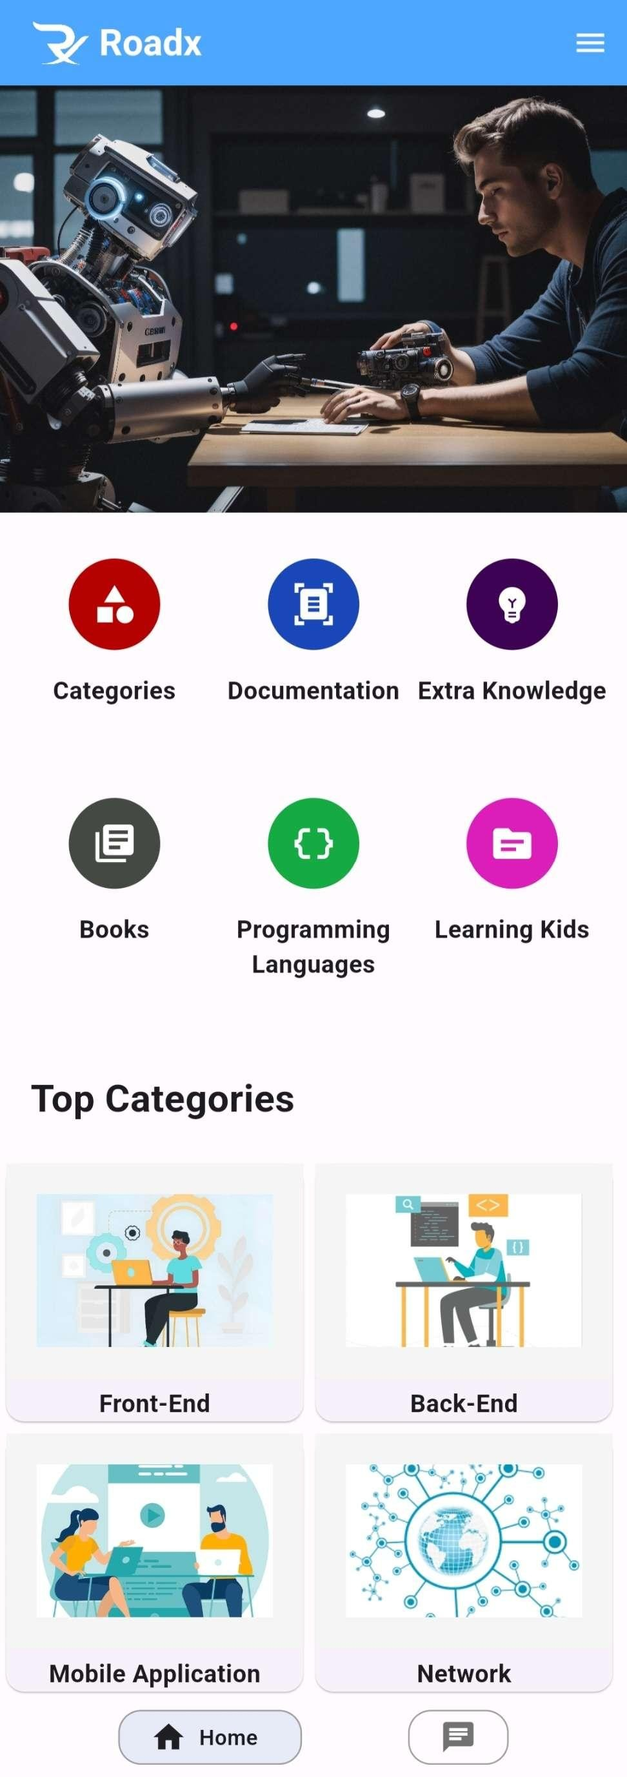
Mobile Application
We Provide most of programming fields with the most famous resources available
We provide the most famous programming languages
We provide books for trending programming fields
There are educational resources available for children to enhance their understanding of computer systems

Slide 26


Categories
It contains the most programming fields.
Documentation
Documentation plays a crucial role in nurturing users' intellectual growth throughout their learning journey.

Slide 27


Extra Knowledge
Familiarity with modern frameworks, it is including collaboration between development and operations teams, and continuous improvement essential in the world of programming.
Books
It contains books that facilitate structured learning and provide extensive coverage.

Slide 28
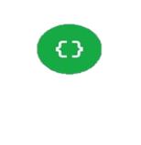

Programming Languages
It contains the most famous programming languages
Learning Kids
It contains educational resources have the potential to enhance children's comprehension of computer systems.

Slide 29
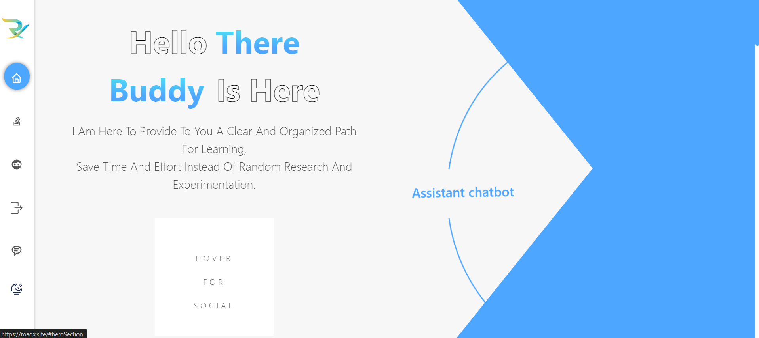
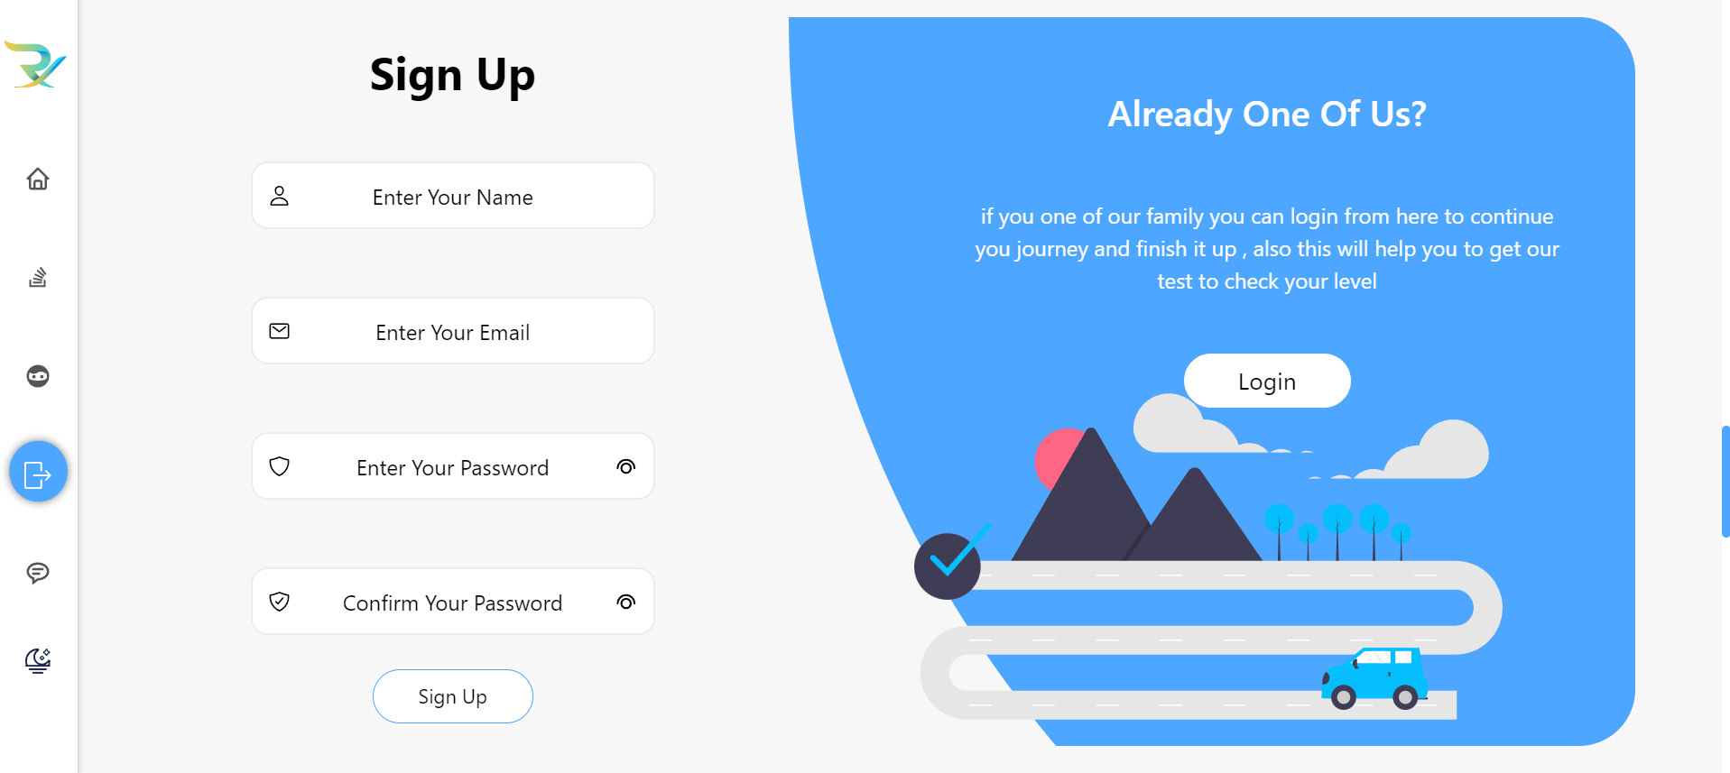
Web Application
The website can be easily accessed by the user
Friendly authenticated system

Slide 30
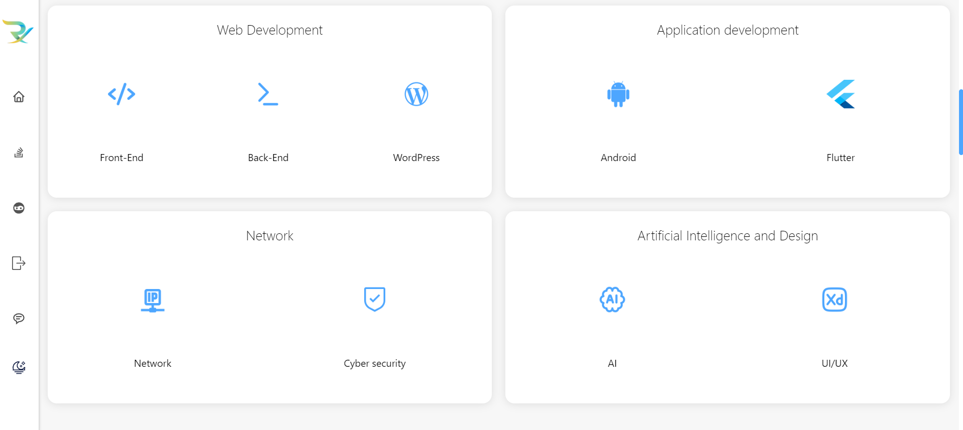
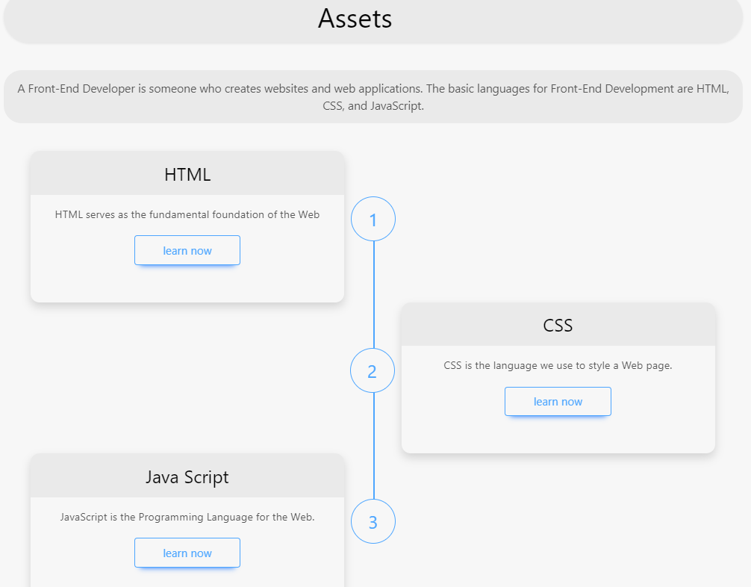
Web Application
There are courses to learn the most famous programming fields
Facilitating time and effort in searching for learning resources in programming fields

Slide 31
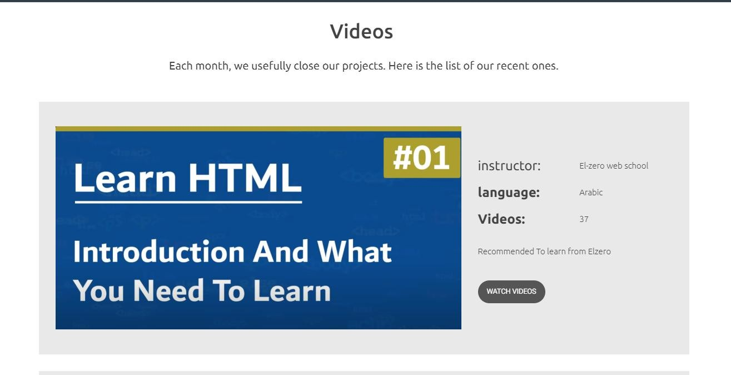
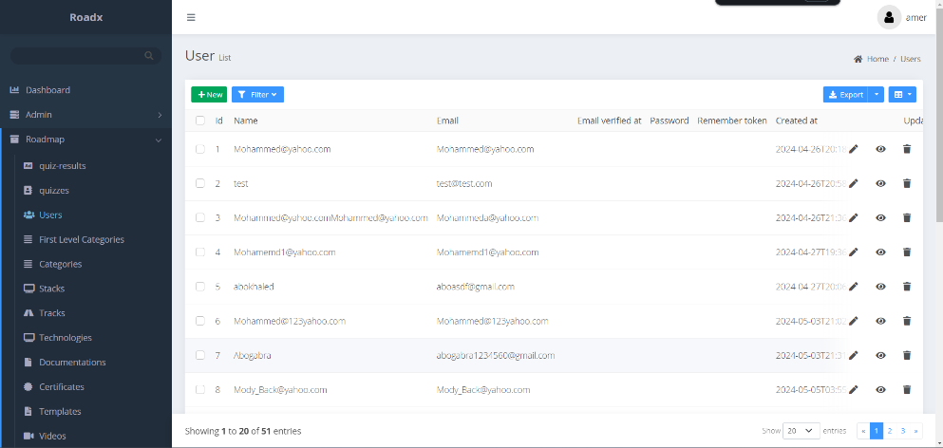
Web Application
He has the ability to view videos and peruse documents and books that are unrelated to his preferred field.
Designed to support the updating of content

Slide 32
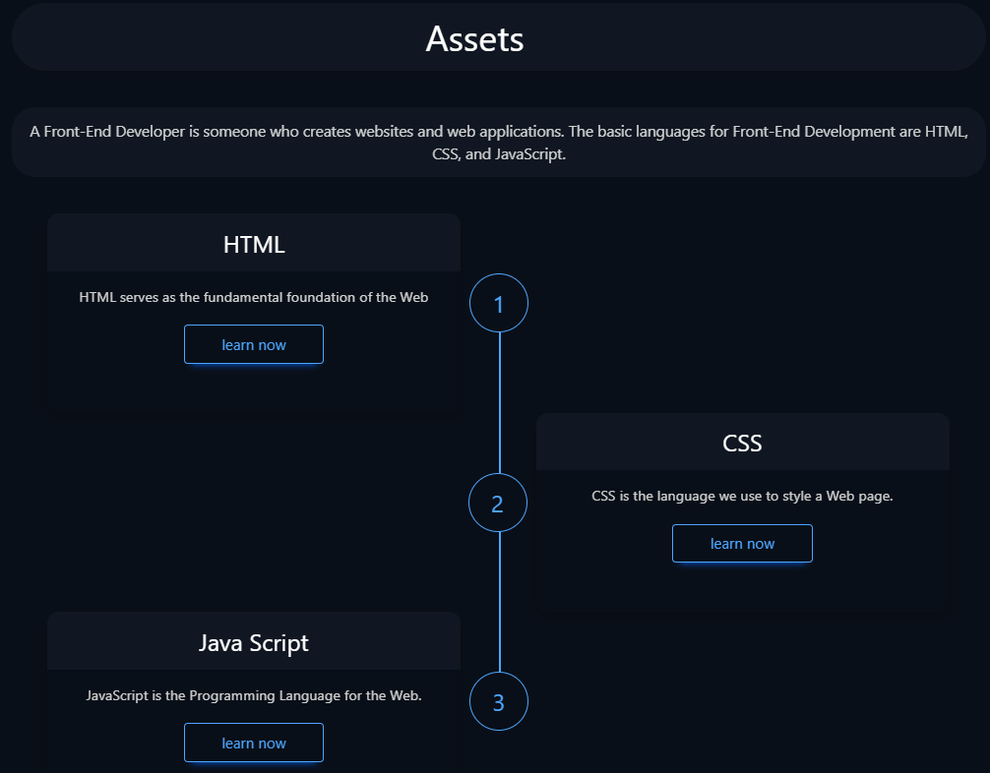
Dark mode feature
Dark mode
Light mode

Slide 33
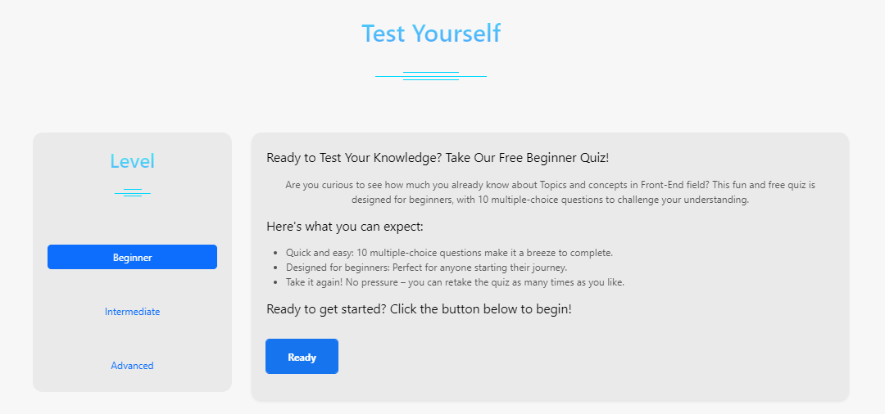
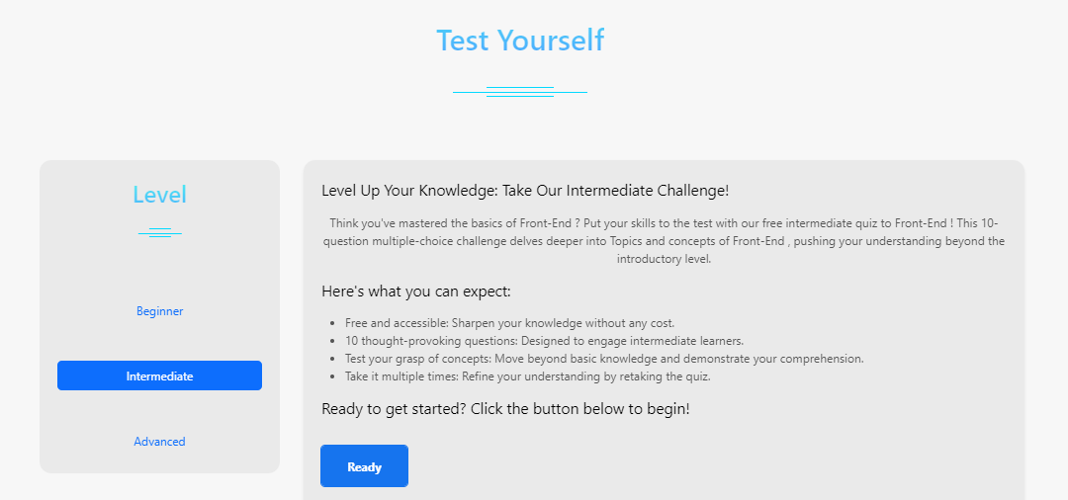
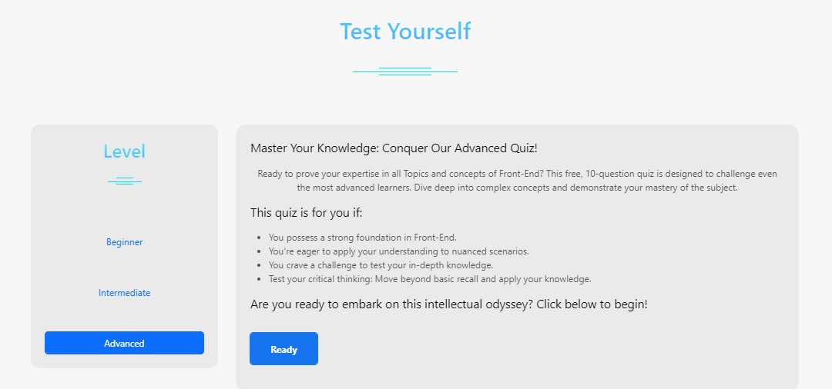
Test yourself
Allows users to test their knowledge and skills through quizzes of varying difficulty levels.
Beginner
Intermediate
Advanced

Slide 34
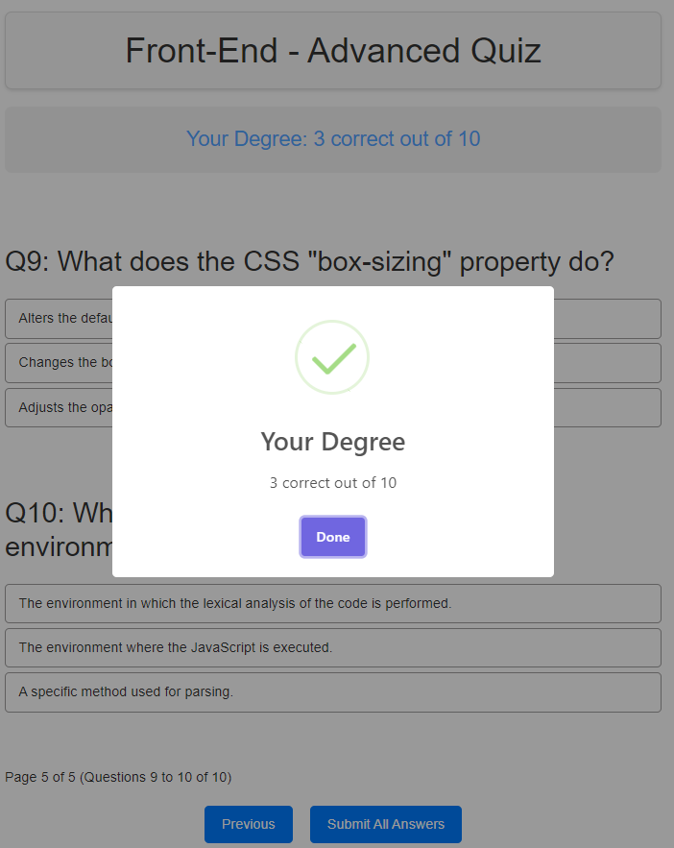
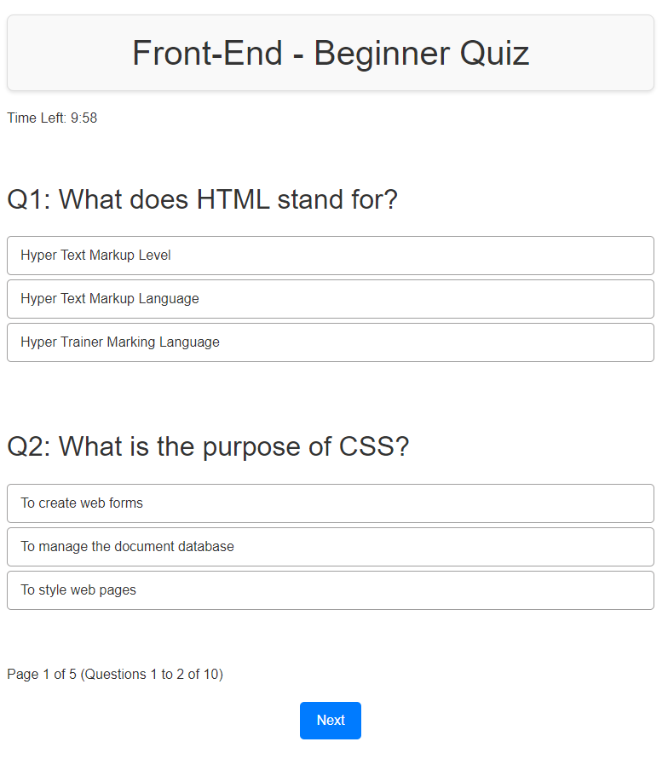
Advanced quiz platform designed to assess knowledge in a particular field. This system offers a well-organized and engaging approach for users to evaluate and improve their programming skills across different proficiency levels.

Slide 35

Machine Learning
What is a chatbot?
is a software application or web interface that is designed to mimic human conversation through text interactions.
Modern chatbots are typically online and use generative artificial intelligence systems that are capable of maintaining a conversation with a user in natural language and simulating the way a human would behave as a conversational partner. Such chatbots often use deep learning and natural language processing.

Slide 36
Using a chatbot on websites provides several advantages and benefits, including:
03.Time saving for users
01.Improve User Experience
02.Customer Service
Users can interact instantly and seamlessly with the website using chat.
Offers users new and innovative ways to interact instead of using the traditional
Chatbots can be used to provide chat-based support to users, responding to their queries instantly.
Reduces the need for users to navigate between website pages to find information.
Makes it easy for users to access the information they need without navigating through the site.
Chatbots can provide clear programming concepts.

Slide 37
Machine Learning
04.Lead Generation
05.Data Analysis
06.Interactive Experience
Chatbots can interact with website visitors and guide them toward suitable services or products.
Effective interaction can lead to higher conversion rates from visitors to customers.
Analyzing chat logs helps understand customer needs and improve their experience
Chatbots add an interactive and personal element to the website, making the user experience more enjoyable

Slide 38
Machine Learning
Comparison.
 | Deep Neural Network | Natural Language Processing | Convolutional neural network
Data Set Size | 15272 | 15272 | 15272
Number of classes | 412 | 412 | 412
Accuracy | 0.9571 | 0.9335 | 0.8206

Slide 39
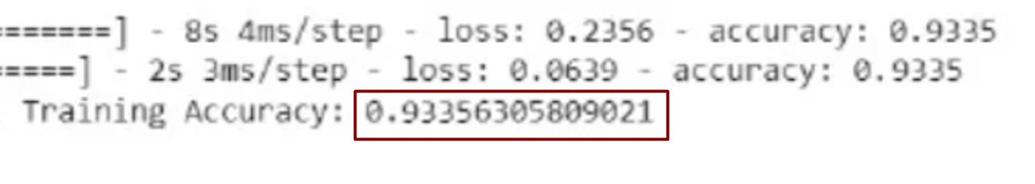
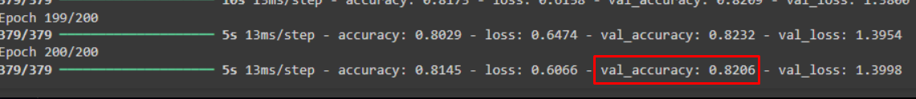
Machine Learning
Natural language processing
Convolutional neural network

Slide 40
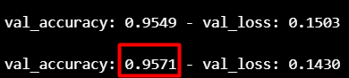
Machine Learning
Deep Neural Network
Why we select DNN?
We selected DNN (Deep Neural Network) as our preferred technology solution due to its exceptional ability to deliver high accuracy and rapid response times.
Overall, the combination of high accuracy and rapid response times makes DNN an ideal choice for our needs and providing a superior user experience and meeting the demands of our customers.

Slide 41
Machine Learning
Deep Neural Network
A deep neural network (DNN) is a type of artificial neural network (ANN) with multiple layers between the input and output layers. These networks are called "deep" because they have more than one hidden layer, distinguishing them from simpler models that have only one or no hidden layers.
It creates an adaptive system that computers use to learn from their mistakes and improve continuously.
Artificial neural networks attempt to solve complicated problems,with greater accuracy.

Slide 42
08.
Prototype

Slide 43
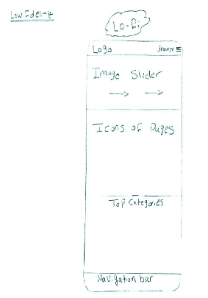
Mobile Application
Low Fidelity
High Fidelity

Slide 44
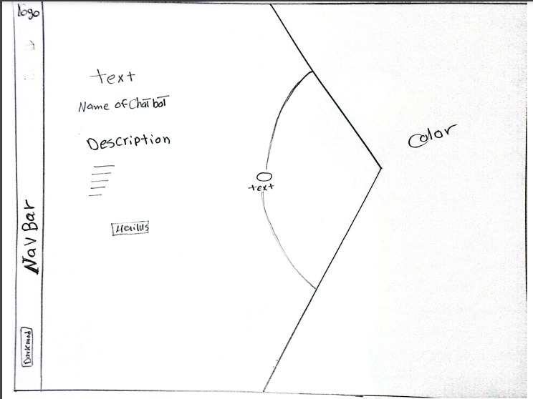
Frontend
Low Fidelity

Slide 45
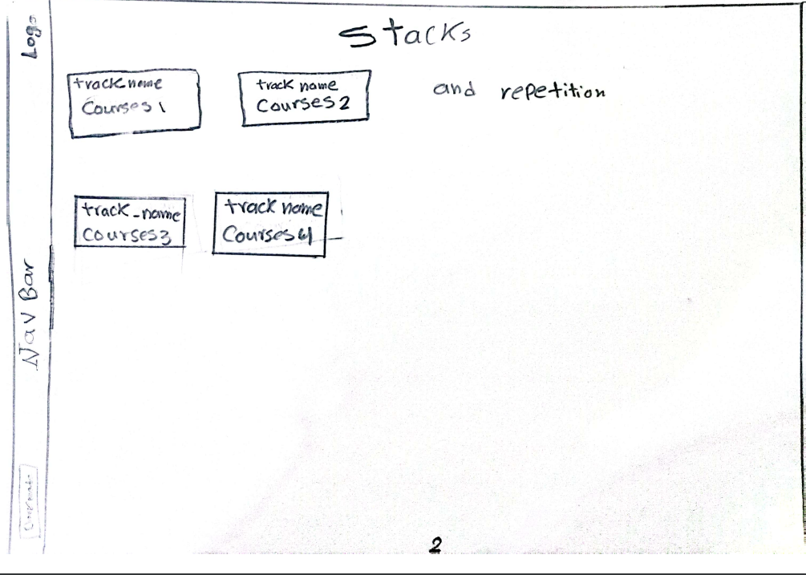
Frontend
Low Fidelity

Slide 46
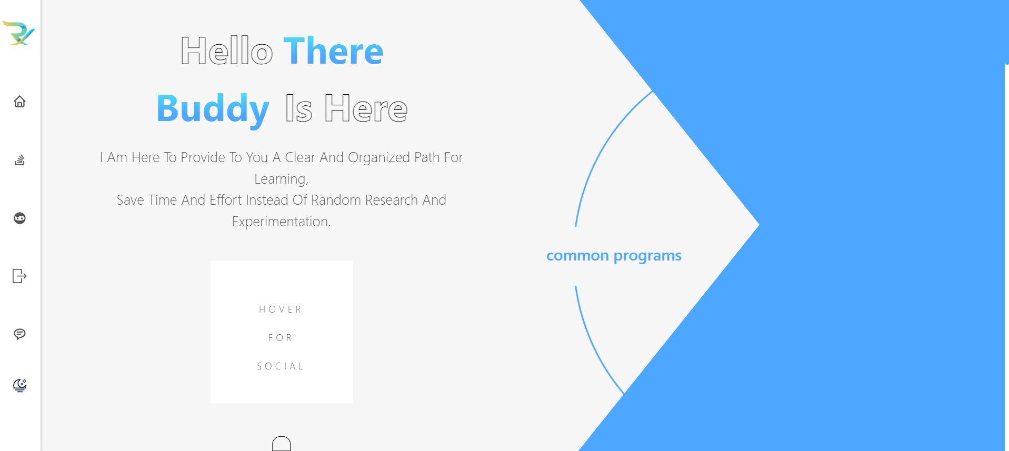
Frontend
High Fidelity

Slide 47
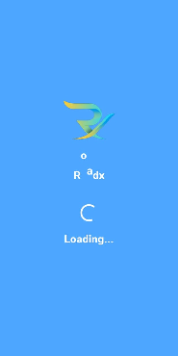
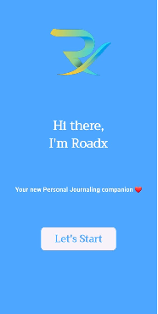
Designs
Mobile Application
Logo
Welcome Screen

Slide 48
Designs
Mobile Application
Home Page

Slide 49
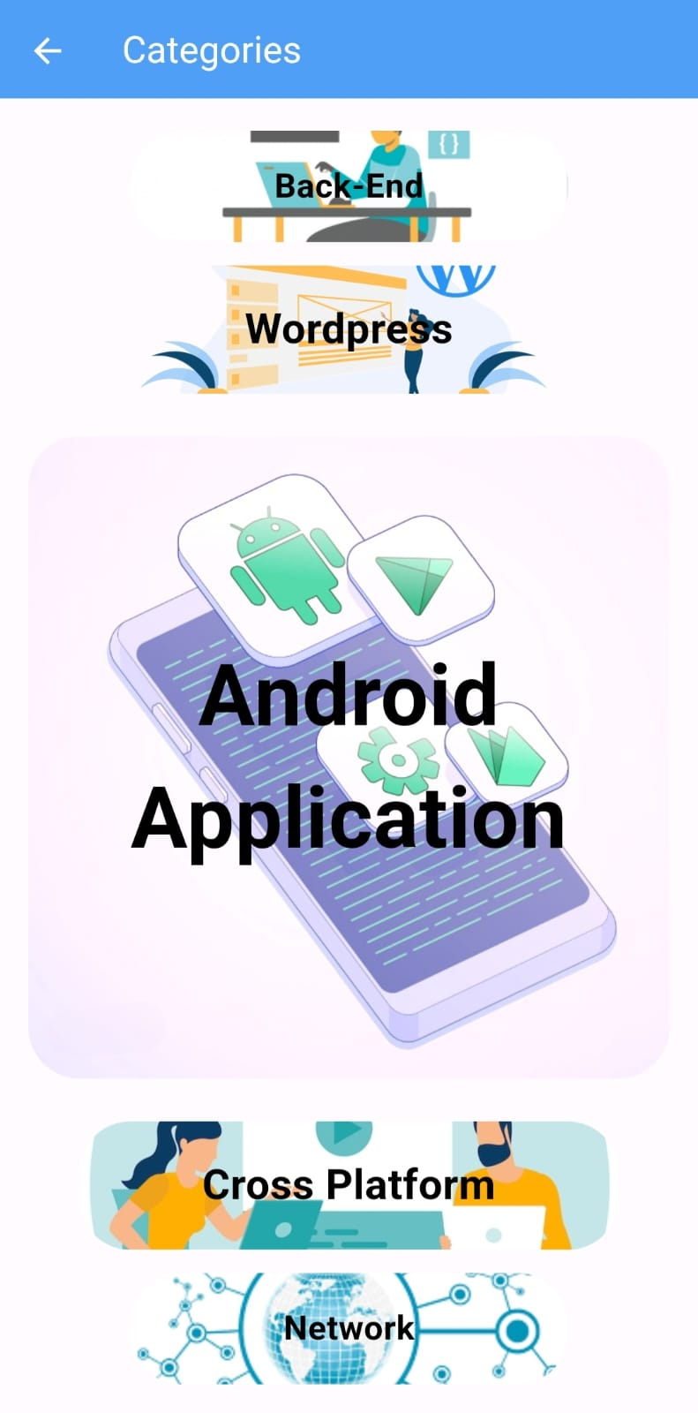
Designs
Mobile Application
Categories Page

Slide 50
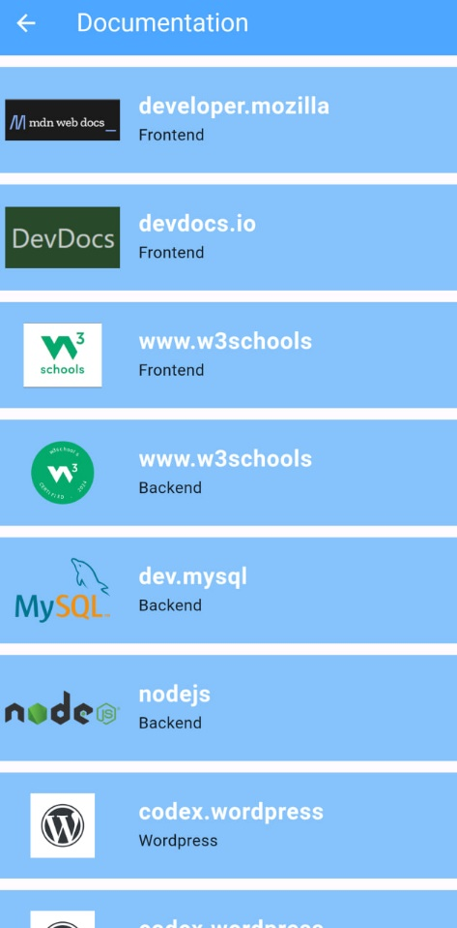
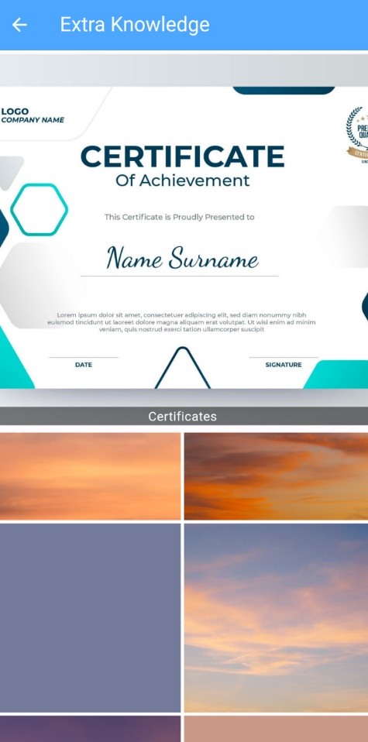
Documentation Page :
Extra Knowledge Page :

Slide 51
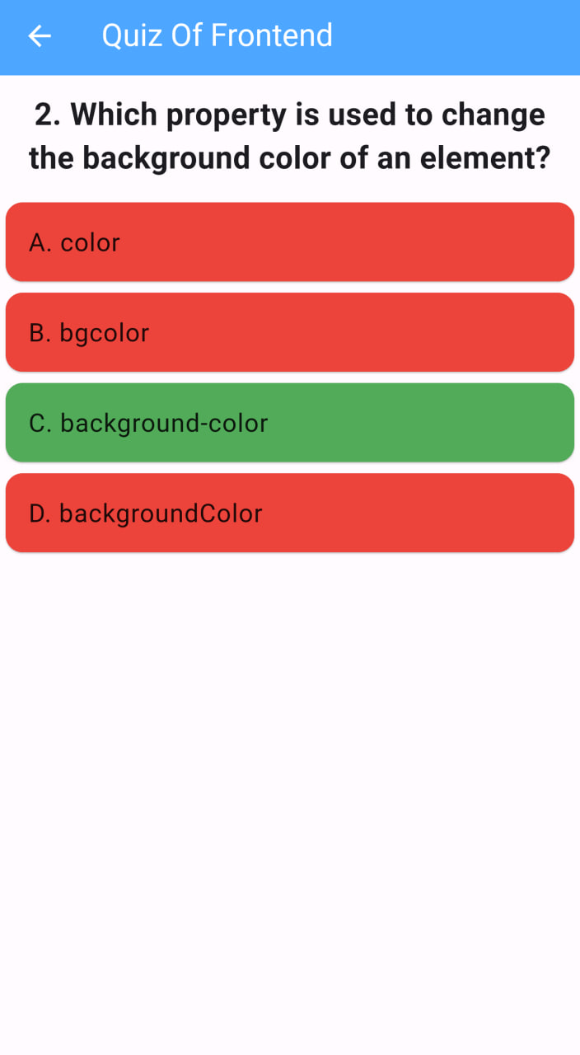
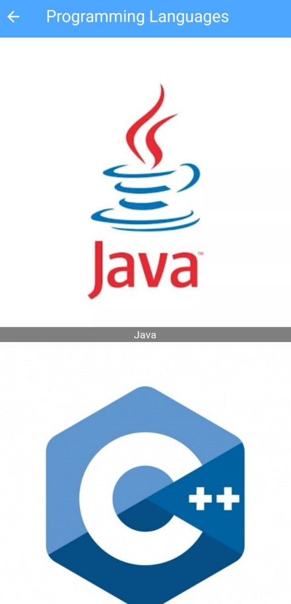
Programming Language Page :
Quizzes Page :

Slide 52
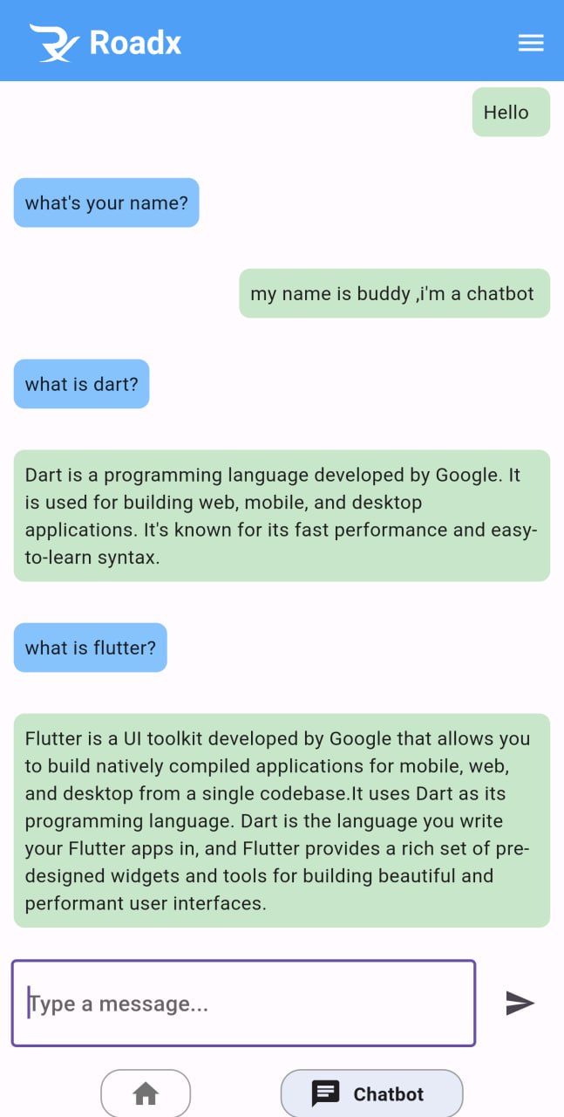
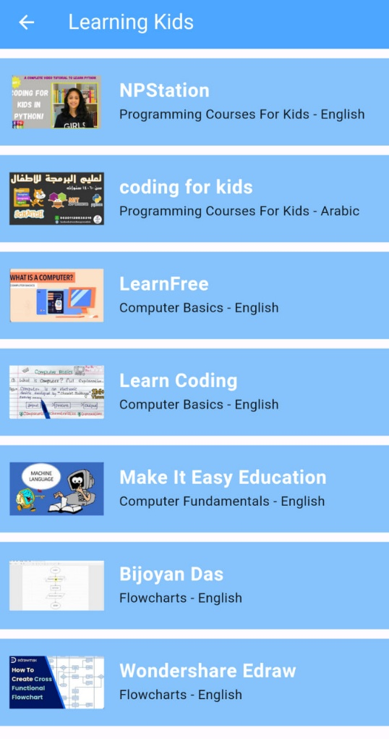
Chatbot Page :
Learning Kids Page :

Slide 53
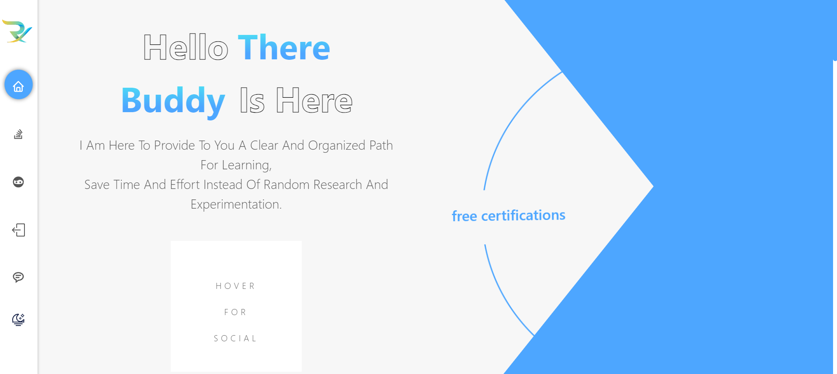
Frontend:
Welcome Screen

Slide 54
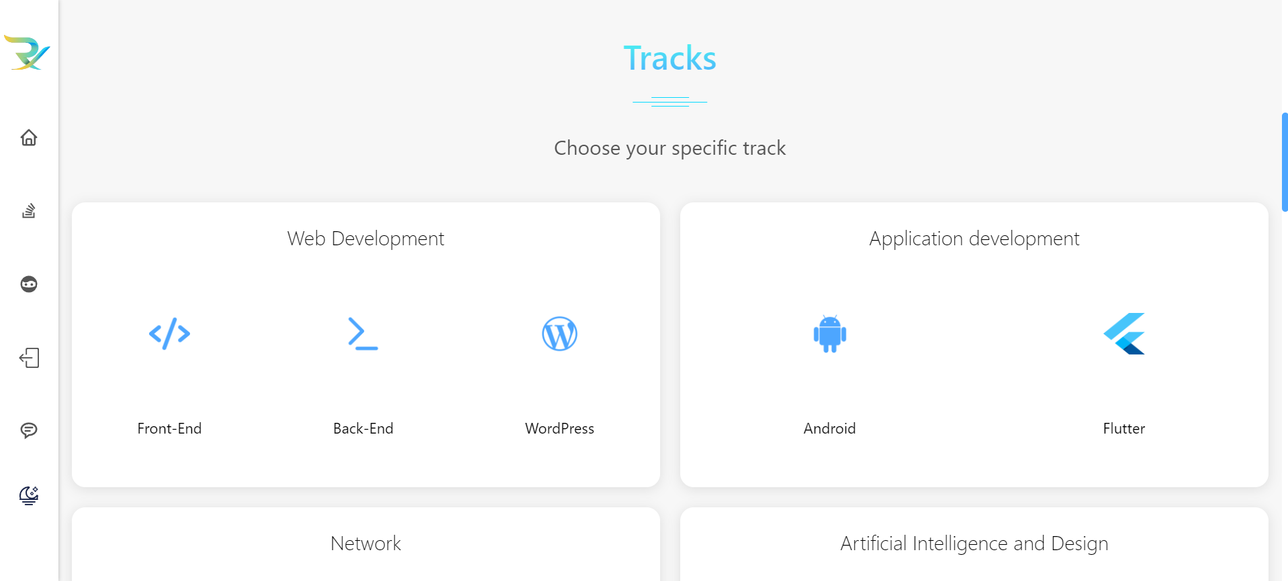
Frontend:
Tracks Page

Slide 55
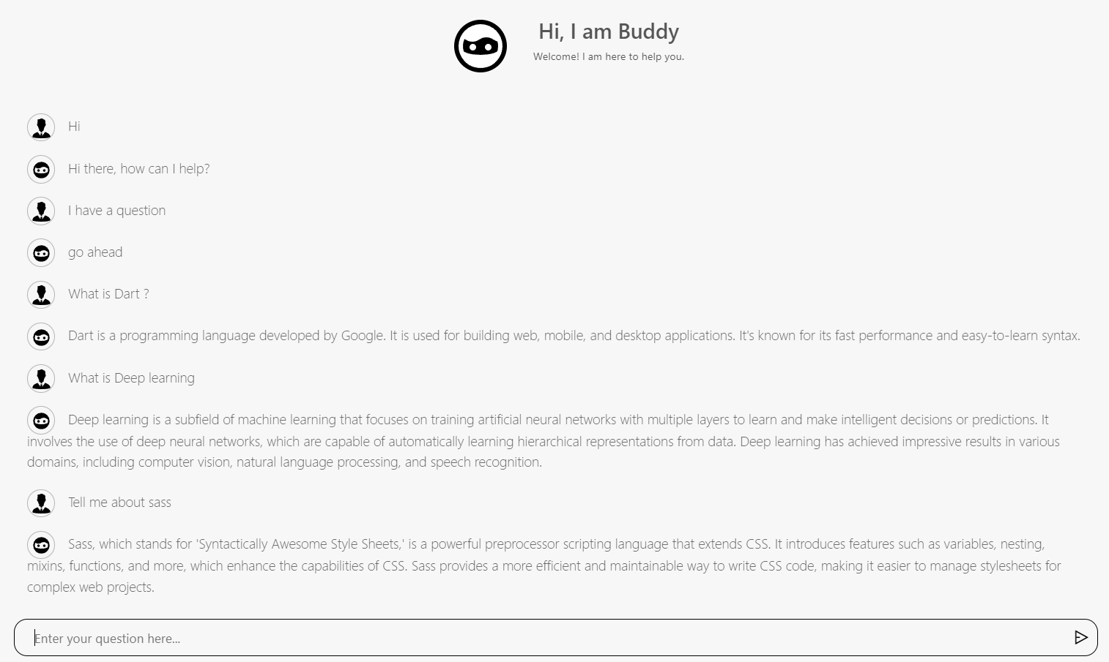
Frontend:
Chat Bot Deisgn

Slide 56
Frontend:
Sign up Page

Slide 57
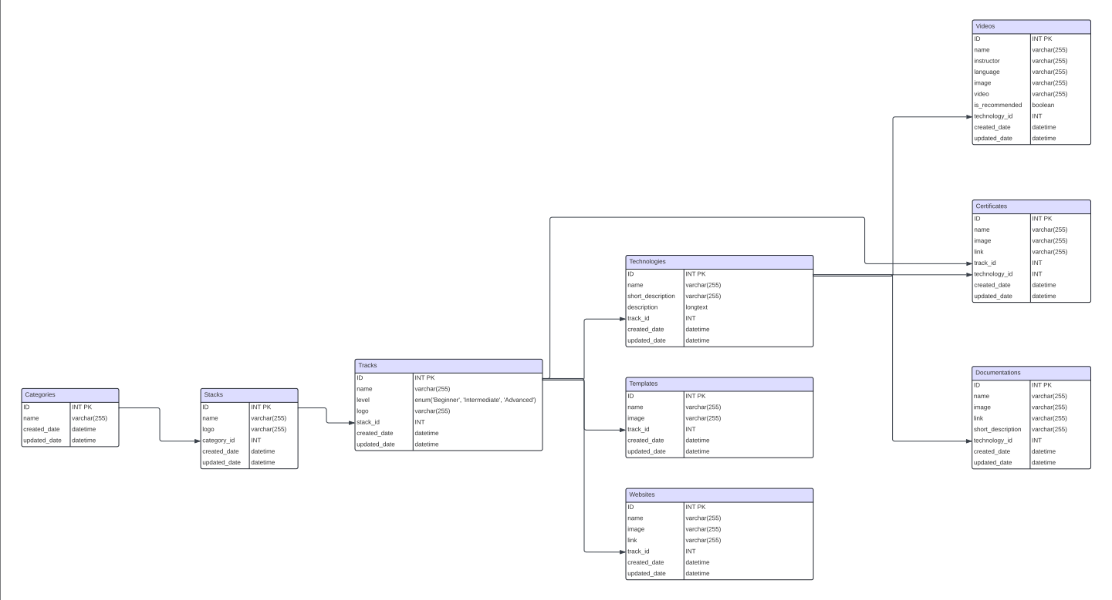
ERD

Slide 58
Procedure for Mobile App
Design logo (Completed)
Design:
Prototype (Completed)
Categories Page (Completed)
Tracks content (Completed)
Send feedback (Completed)
Contact us (Completed)
Visit our website (Completed)
Dark mode (Completed)
Quiz system (Completed)
Image slider (Completed)
Splash screen (Completed)
Welcome Screen (Completed)
Icons (Completed)
Setting (Completed)
Low Fidelity (Completed)
High Fidelity (Completed)

Slide 59
Procedure for Web
Design logo (Completed)
Design:
Authentication (Completed)
ERD (Completed)
Layout (Completed)
Collecting Resources (Completed)
Migration (Completed)
CRUD (Completed)
Link Chatbot (API) (Completed)
Header (Completed)
Home page (Completed)
Stack Page (Completed)
Track page (Completed)
Register page (Completed)
Login Page (Completed)
Splash screen (Completed)
Feedback page (Completed)
Admin Dashboard Page (Completed)
Responsive (Completed)

Slide 60
Procedure for Ai
dataset collect (complete)
read papers (complete)
choice models (complete)
build chatbot (complete)
Api (complete)
complete dataset (complete)

Slide 61
09.
Time plans

Slide 62
Months | Goals | Discribtion | Duration
OCT | Requirements are specified Analyzing the Requirments estimate how much time per task | We will create a project brief organizing the project scope | 2-3 weeks
Nov | We choose the logo and We set the best prototype | Design choices Choose the most effective | 3-4 weeks
Dec | Develop our project | we start implementing the prototype , test all features | 4 Weeks
Jan | We Collect the Resources We collect the dataset | Preprocess and clean the data, ensuring it's suitable for training machine learning models if needed. | 2 Weeks
Feb | Testing The Project and verify it | ensure that the project works as expected, meets requirements, and is free of bugs. | 3 Weeks

Slide 63
Months | Goals | Discribtion | Duration
Mar | We Finish the reaming requirement | We will finish all requirement and preprare the project to be tested | 2-3 weeks
Apr | Build Quiz system We Finish the reaming requirement | We will finish all Quiz system login and prepare the project to be tested | 3-4 weeks
May | Test our project | We will test the project and ensure the the effectiveness of the project | 4 Weeks

Slide 64
10.
Videos

Slide 65
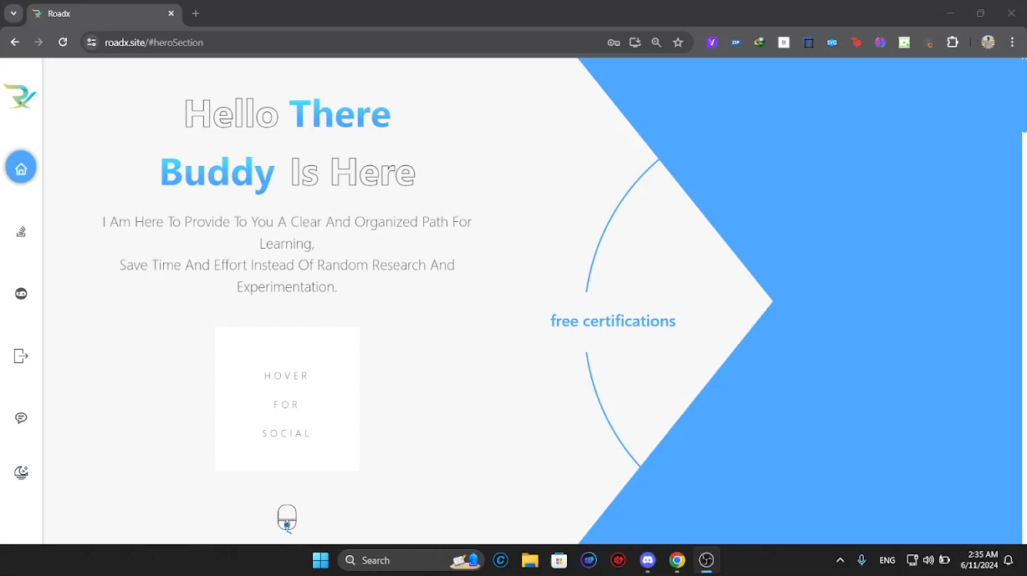

Videos
Web Application
Mobile Application

Slide 66
11.
References

Slide 67
References
https://www.pinterest.com/
https://www.pexels.com/
https://www.freepik.com/
https://color.adobe.com/create/color-wheel
https://www.sciencedirect.com/science/article/pii/S1110016820304907
https://www.quora.com/How-can-I-convert-a-research-paper-to-a-deep-learning-model
https://www.sciencedirect.com/science/article/pii/S1110016820304907

Slide 68
THANKS!
we hope that we had impressed you

